Slide 1
Data Science Platform - Regulation and Securing
Preetam Balijepalli
ML Solution Archictect
18/03/2020

Slide 2
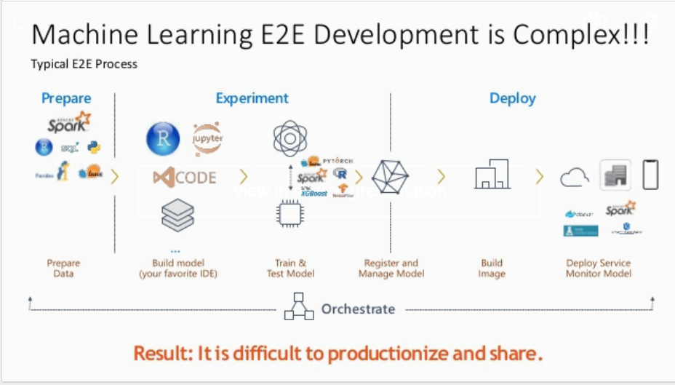


Slide 3
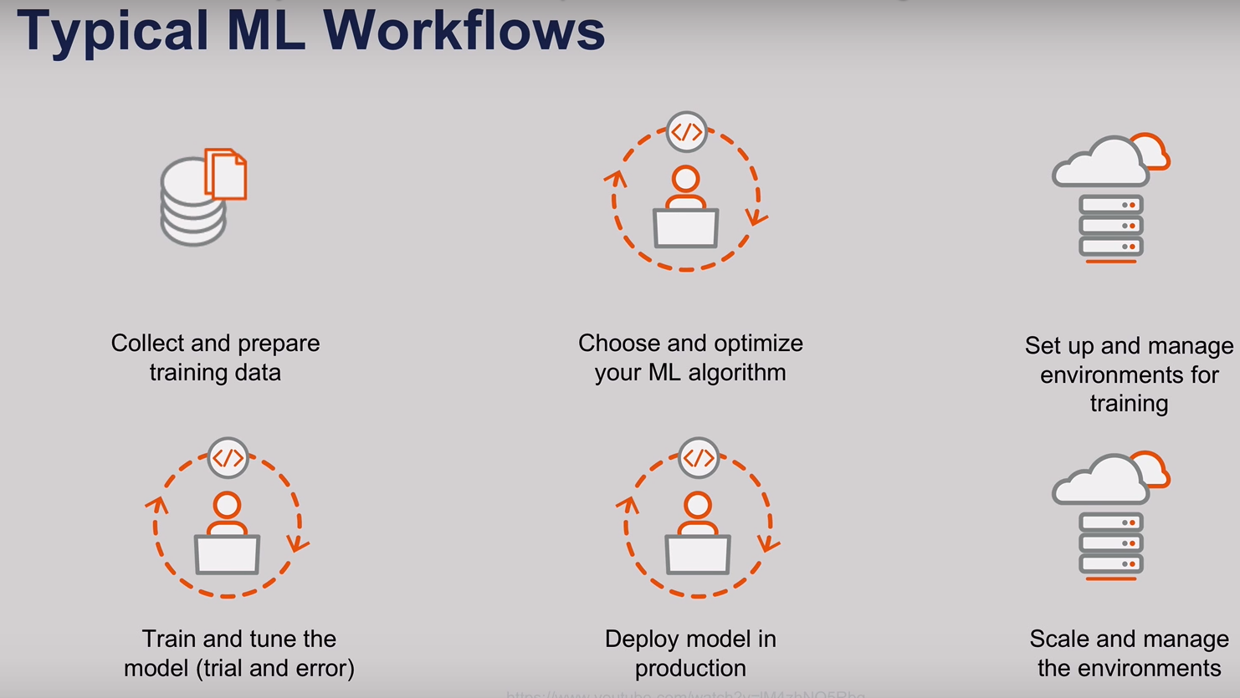

Slide 4
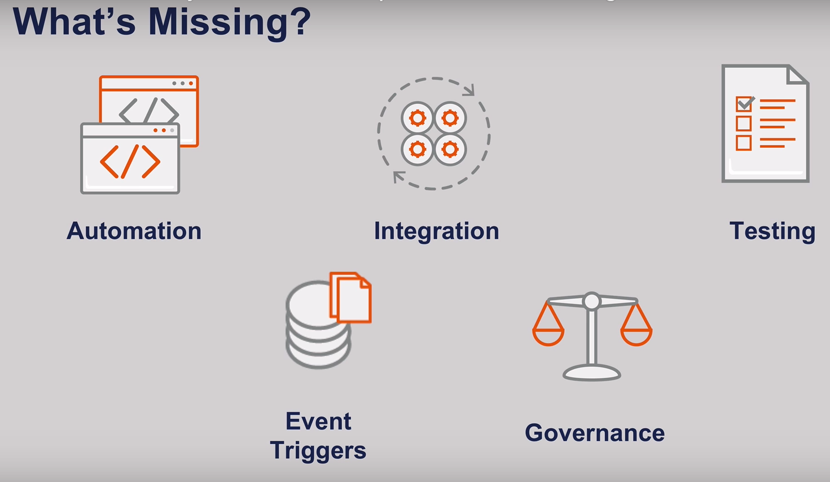

Slide 5
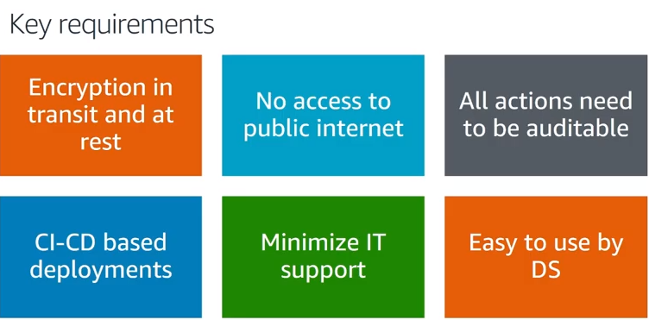

Slide 6
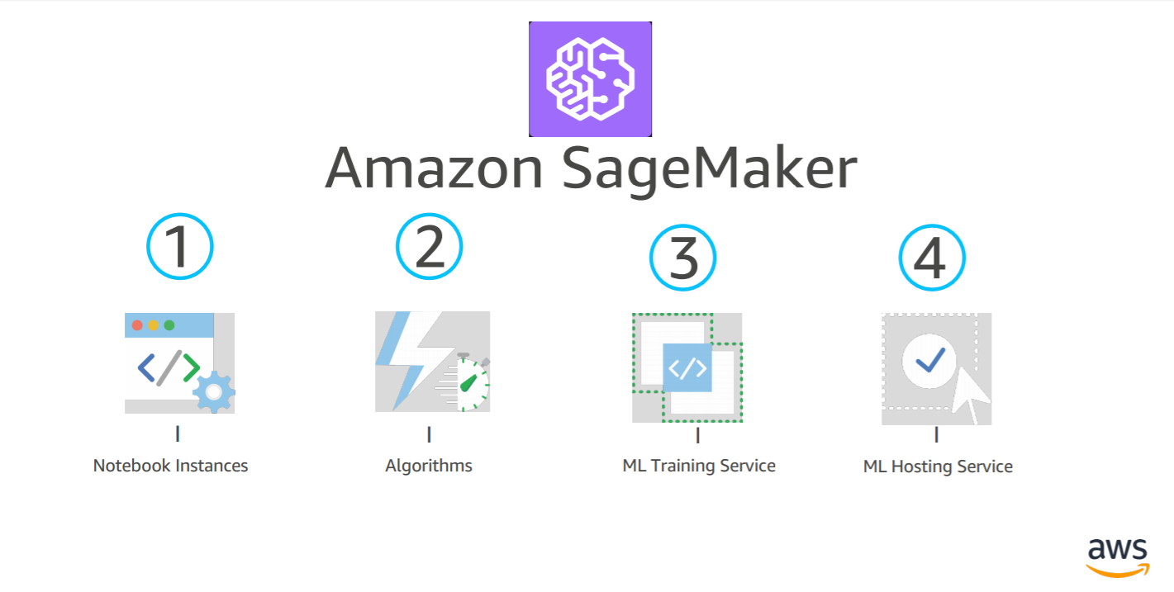
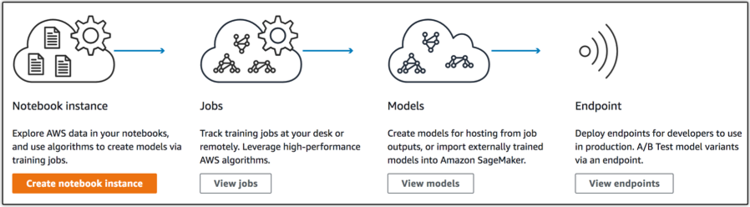
A fully managed service that enables data scientists and developers to quickly and easily build machine-learning based models into production smart applications

Slide 7
Infra As Code Lifecycle - Faster, Repeatable , Stable , Secure , Visible ,Versionable and Auditable
Provisioning
Self Service
Standardization of Configuration Service Catalog
Automation of Governance (Security(IAM , No internet access) Constraints(IP address, Machine , quota) Tags)
BYO Algorithm ( Lambda and Cloud watch ,IAM)
Storage requirements
Configuration
Mutable – mostly user app specific
Potential choice Ansible
Infra
Deploy and destroy the environment
Immutability with automation
Potential choice Gitlab ,Cloud Formation, Terraform
Auditability
Cloud watch , SNS , ELK , Graphana
Trigger
- Airflow(Hosted over ECS) Job or Lambda function is triggered to execute a training job

Slide 8
Threat Model
Component | Role | Threat | Severity | Current Definition | Enablement | Comments/Remarks
GitLab | Code versioning , CI-CD | Code accessibility | Low | Secured as its over https and SSO enabled and no internet access Deployed over open stack – CE team to confirm how its secured | Available | Need to check if this can be easily integrated with AWS or do we need to fall back to AWS code build and pipeline Currently the metadata store for the tool is SQL lite need to finalize a database store. Need to also check if there are any firewall requests to be taken care while integrating with AWS
MLFlow | Model Lifecycle management (Tracking, Packaging ,Repository) | Sensitive user information w.r.t Compliance, data(e.g. passwords) |  | AD Integration – Not Available Cluster - Not Available | Available | Need to establish authentication on our own , Scale with the help of ECS or other services Currently the metadata store for the tool is SQL Lite need to finalize a database store.
Airflow | DAG(ML and Data Pipeline) |  |  | AD Integration – Not Available Cluster - Not Available | Available | Need to establish authentication on our own , Scale with the help of AWS ECS or other services Trade-off analysis done ,need to finalize if we are going to stick with Airflow or AWS Lambda and Step Functions due to its features
Nexus + Artifact repositories | Repository for docker , python packages, YUM, R-Package manager , Anaconda |  |  |  | Available | Currently we can only fetch those which are configured Need to understand a mechanism how to create repos project specific or upload our own packages If there is a chance to whitelist packages from GitHub or Bitbucket source repos
ELK |  |  |  |  | Not Available | Need to do a proof of evaluation to decide if ware going to use ELK or AWS components

Slide 9
Threat Model
Component | Role | Threat | Severity | Mitigation | Enablement | Comments/Remarks
SageMaker | Model development, training and serving |  |  | IAM Assume Roles + MFA | Partially Available | Currently there is no model development env, It’s a JupyterHub on EC2 (Private VPC etc. to adapt SageMaker Notebook) We need to finalize if we are going to use any tool like OKTA, currently we use Google Authenticator
ECR | Repository for the prebuilt, custom docker Images used as part of model training, serving | Data transmitted between containers during distributed computing Container Attack |  | IAM Assume Role + MFA TLS(https end points are exposed ) Containers are encrypted by ECR | Available | we can establish certificated if needed.
ECS | Scale the components which are not provided by AWS like MLFlow and Airflow | Container attack Communication between Containers Data transmitted between containers during distributed computing |  |  | Not Available
Lambda | Access end points to return predications Trigger pipelines (Code or ML) | Event injection Serverless attacks(API calls , parameter configuration, Cloud storage access etc.) |  |  | Not Available
EC2 |  |  |  | Security Groups and Private VPC | Available | Currently we have 3 machines used for JupyterHub, Airflow , MLFlow, RStudio We can also restrict I/P addresses if we want to

Slide 10
Threat Model
Component | Role | Threat | Severity | Current Definition | Enablement | Comments/Remarks
SNS | Notification – For Pipeline Failure Approval process for state transition into production |  |  |  | Not Available
Gateway | Maintain and Monitor End points |  |  |  | Not Available | Not an immediate priority
Cloud Formation | Automating Sagemaker |  |  |  | Available
Cloud Watch | Log aggregation | Data(API or User , Code) protection in the logs Compliance(GDPR) Validation |  |  | Available
Cloud Trail | Rest API monitoring
AWS IAM |  |  |  |  | Available | Need to understand from CE team what are the current definitions Need to check if it can be used to define data science specific roles
Service Catalog | Fine grained access and charge back model , Standardization |  |  |  | Not Available | Need to understand multi-account strategy which is coming up

Slide 11
Threat Model
Component | Role | Threat | Severity | Mitigation | Enablement | Comments/Remarks
S3 | Data | Data Loss/ Sensitive Data |  | IAM Assume Role + MFA + Private buckets | Available
Parameter Store | Store password and other app configurations |  |  |  | Not Available
RDS/NoSQL | Metadata Store |  |  |  | Not Available
Private

Slide 12
Threat Model
Component | Role | Threat | Severity | Mitigation | Enablement | Comments/Remarks
Text Extraction | ML Service for text extraction | Data Loss/Sensitive Data |  |  | Not Available
Sagemaker Neo
Private

Slide 13
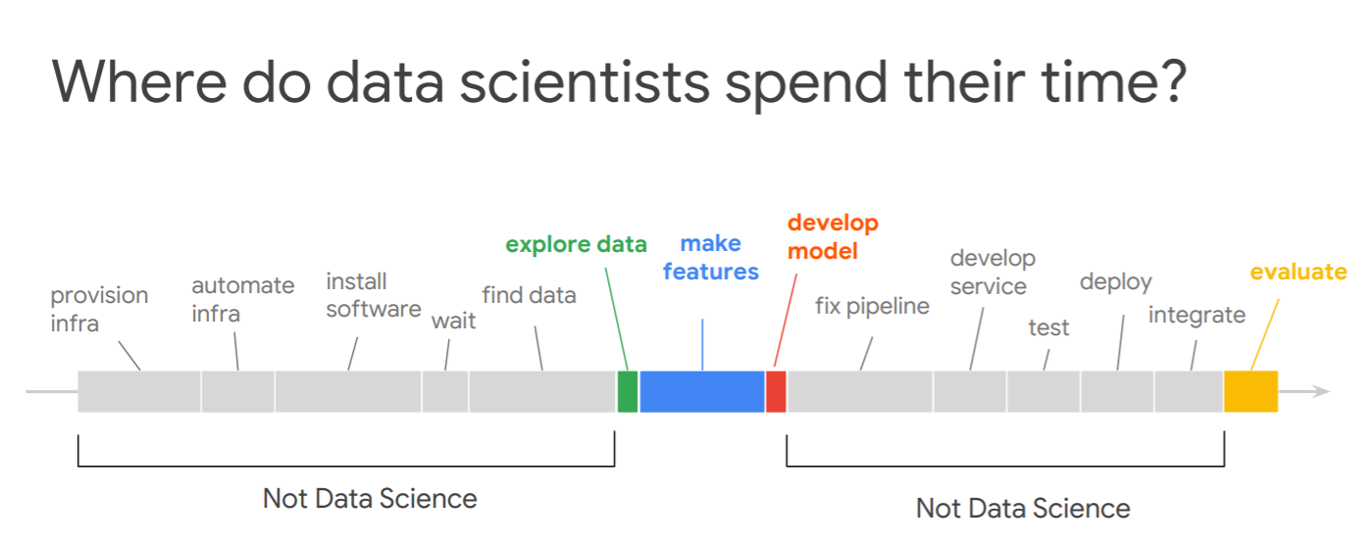

Slide 14


Thank You !

